Slide 1
Text Mining
DSBA/MBAD 6211

Slide 2
Objectives
Text mining overview
Math behind text mining
Methods for parsing and quantifying Text
Latent semantic analysis via the singular value decomposition
Topic modeling
Similarity measures
Python applications
A simple example to illustrate key concepts
A predictive model based on text mining

Slide 3
Text Mining Overview

Slide 4
Corporate Knowledge “Ore”
Unstructured data not very accessible via standard data-mining
Email
Insurance claims
News articles
Web pages
Patent portfolios
IRC
Scientific articles
Customer complaint letters
Contracts
Transcripts of phone calls with customers
Technical documents

Slide 5



Text Mining Definition
Definition
An exploration and analysis of textual (natural-language) data by automatic and semi automatic means to discover new knowledge.
Text Mining
Natural Language Processing
=
Data Mining
+

Slide 6
Data Mining vs. Text Mining
Both seek for novel and useful patterns
Both are semi-automated processes
Difference is the nature of the data:
Structured versus unstructured data
Structured data: in databases
Unstructured data: Word documents, PDF files, text excerpts, XML files, and so on
Text mining – first, impose structure to the data, then mine the structured data

Slide 7
Text Mining
What is “previously unknown” information ?
Lenient definition
Rediscover the information that the author encoded in the text
e.g., Automatically extracting a product’s name from a web-page
Strict definition
Information that not even the writer knows.
e.g., Discovering a new method for a hair growth that is described as a side effect for a different procedure

Slide 8
Unknown Pattern: Don Swanson’s Medical Work
Given
medical titles and abstracts
a problem (incurable rare disease)
some medical expertise
Find causal links among titles
symptoms
drugs
results
E.g.: Magnesium deficiency related to migraine
This was found by extracting features from medical literature on migraines and nutrition

Slide 9
Unknown Pattern: Don Swanson’s Medical Work
All extracted from medical journal titles and abstracts
Problem: Migraine headaches (M)
Stress is associated with migraines;
Stress can lead to a loss of magnesium;
Calcium channel blockers prevent some migraines
Magnesium is a natural calcium channel blocker;
Spreading cortical depression (SCD) is implicated in some migraines;
High levels of magnesium inhibit SCD;
Migraine patients have high platelet aggregability;
Magnesium can suppress platelet aggregability.

Slide 10
Unknown Pattern: Don Swanson’s Medical Work
All Migraine Research
All Nutrition Research
CCB
migraine
PA
magnesium
SCD
stress

Slide 11
Information Retrieval
Goal: find a set of documents that are relevant to a user query
Documents
source
Query
E.g. Spam / Text
IR
System
Document
Ranked
Documents
Document
Document

Slide 12
Information Extraction
Goal:
Extract from the documents salient facts about pre-specified types of events, entities or relationships.
Structuring unstructured information
Example:
Salvadoran President-elect Alfredo Cristiania condemned the terrorist killing of Attorney General Roberto Garcia Alvarado and accused the Farabundo Marti Natinal Liberation Front (FMLN) of the crime. … Garcia Alvarado, 56, was killed when a bomb placed by urban guerillas on his vehicle exploded as it came to a halt at an intersection in downtown San Salvador. … According to the police and Garcia Alvarado’s driver, who escaped unscathed, the attorney general was traveling with two bodyguards. One of them was injured.
Incident Date: 19 Apr 89
Incident Type: Bombing
Perpetrator Individual ID: “urban guerillas”
Human Target Name: “Roberto Garcia Alvarado”
...

Slide 13
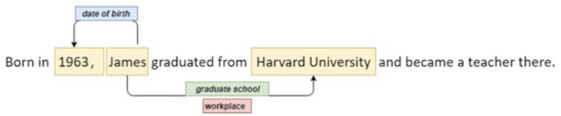
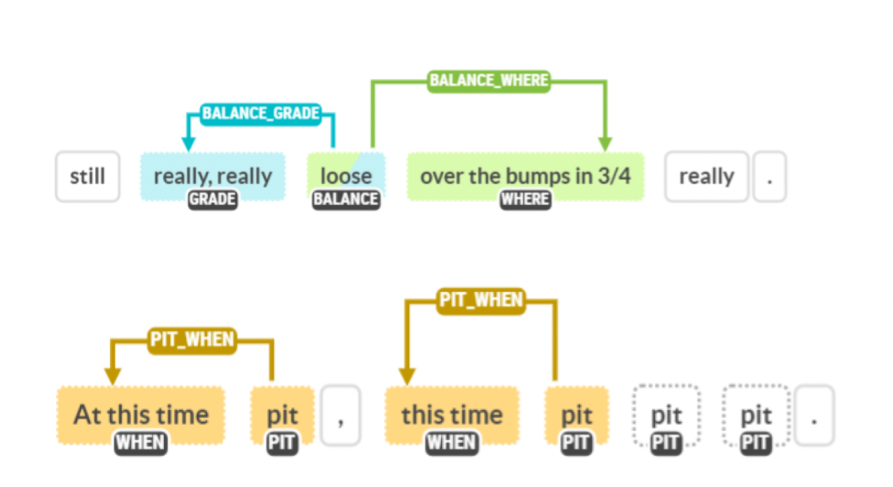
Information Extraction

Slide 14
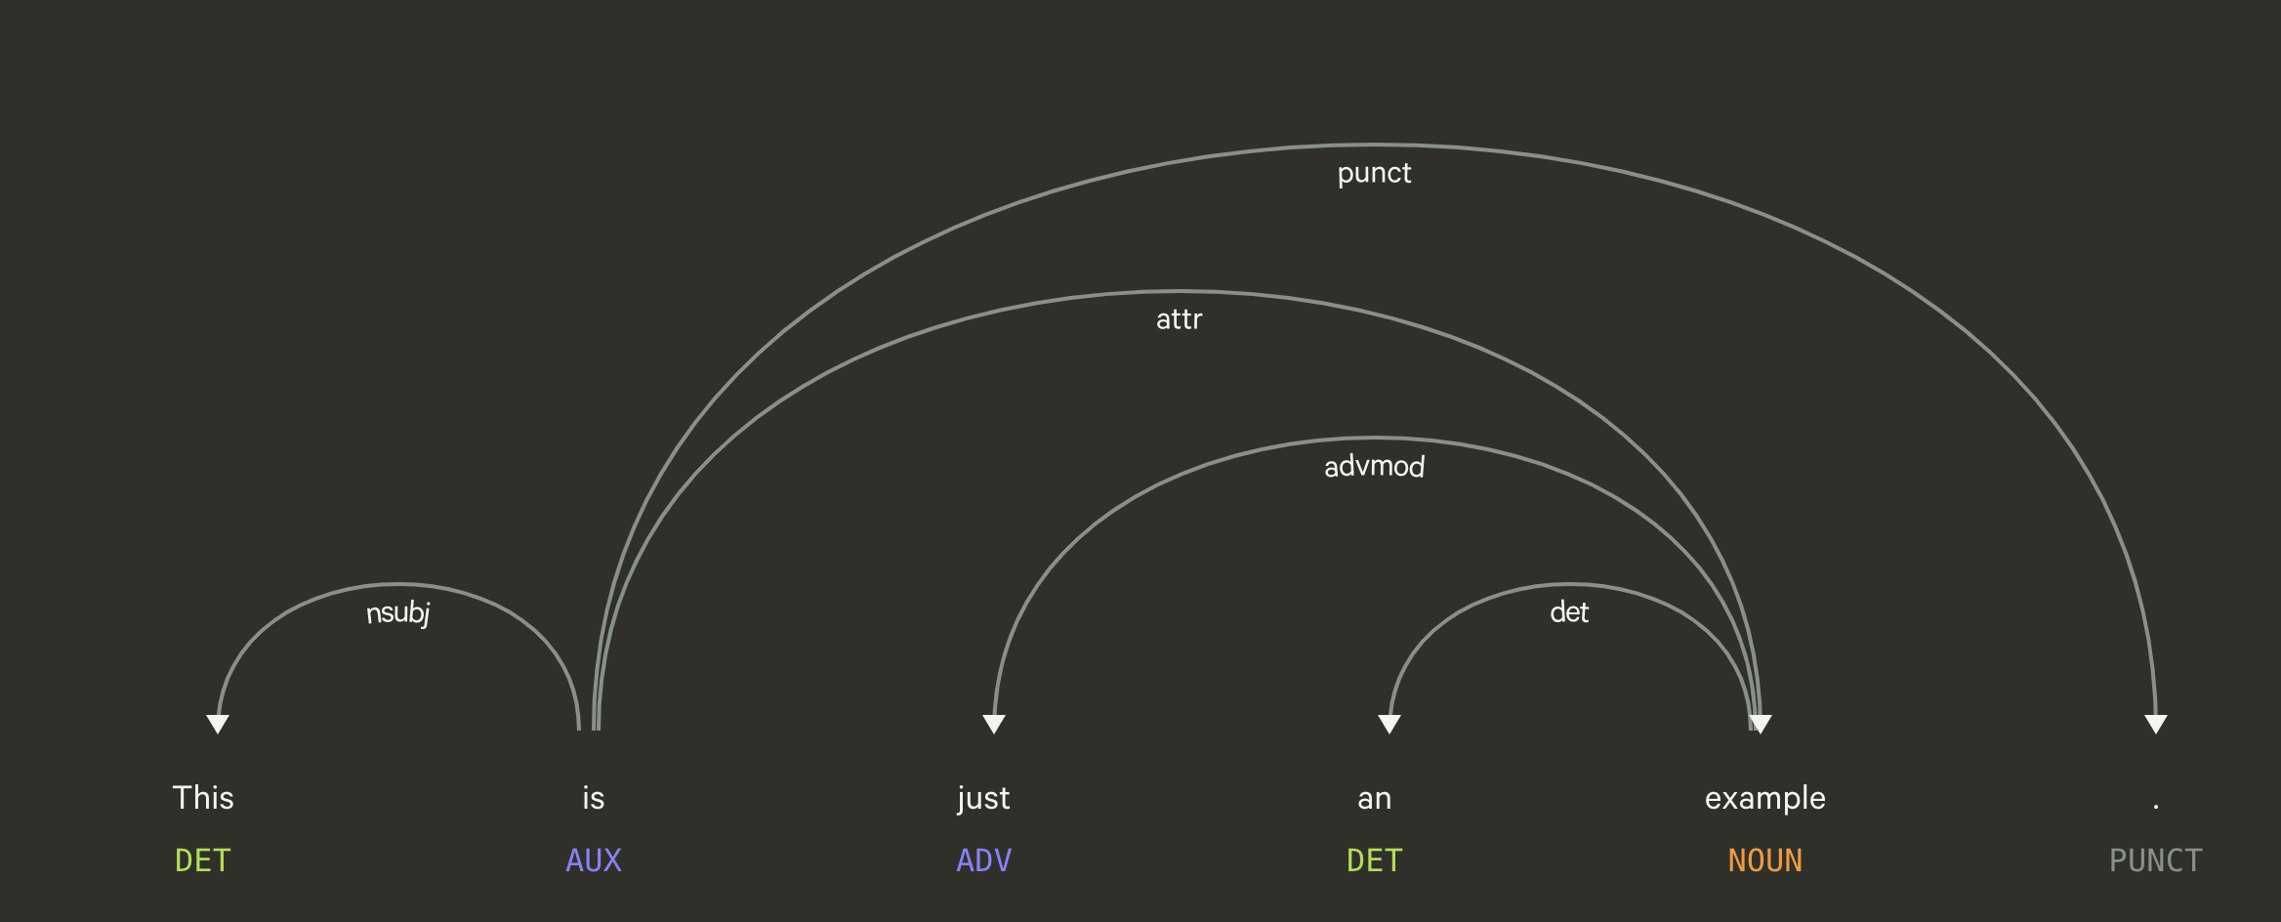
Information Extraction

Slide 15
Clustering
Goal:
Find several clusters of documents that are relevant to each other
Similarity measures
Many variations
One example: how many words are common in these documents
Documents
source
Similarity measure
Clustering
System
Doc
Doc
Doc
Doc
Doc
Doc
Doc
Doc
Doc
Doc

Slide 16
Text Mining Process
Step 1: Establish the corpus
Collect all relevant unstructured data
e.g., textual documents, XML files, emails, Web pages, short notes, voice recordings…
Digitize, standardize the collection
e.g., all in ASCII text files)
Place the collection in a common place
e.g., in a flat file, or in a directory as separate files)
Source: Decision Support and Business Intelligence Systems (9th Ed., Prentice Hall)

Slide 17
Text Mining Process – Topic detection
Documents consist of topics, and topics are collections of words that occur with different probabilities in statistically meaningful ways. In practice topics are not observable in a corpus (a collection of documents) and can be thought of as latent variables or as hidden semantic meanings of the documents.
Topic models are the modeling techniques, the algorithms, that are designed to discover hidden topics within a text and identify the latent structure in a large collection of documents.
They are a class of text analytic methods that are used when investigating new forms of semantic representation.
No prior knowledge of the meaning of the words in a text is required, instead it is assumed that each document consists of topics.
Topic models scan each document and analyze how words co-occur to decide which clusters of words best characterize them. These clusters are then considered topics.
Since topics are used to represent words, topic models can be thought of as feature-based models of similarity. Words that are characterized by high probabilities for a given topic will tend to co-occur more often together and therefore be highly predictive of one another.

Slide 18





Text Mining Process – Topic detection
Documents
Topics
Words
Discovers hidden semantic meaning of the documents

Slide 19
Text Mining Process
Step 2: Create the Document Term/Feature Matrix
Source: Decision Support and Business Intelligence Systems (9th Ed., Prentice Hall)

Slide 20
Text Mining Process
Step 2: Create the Document Term/Feature Matrix (DTM or DFM)
Also called as “bag-of-words” model
Simplify text into vector representation
Do not consider grammar and even word ordering

Slide 21
Text Mining Process
1. Text as a bag-of-words. Words are assumed to be independent of their order, whose semantic meaning is not important. Each of the words in a document is treated as a feature and represented as a dimension in a feature space. Documents are then represented by vectors with components for each word in a document collection. If a word is not present in a document its component will be equal to zero, otherwise it will be some non-negative value. Collections of documents are multidimensional matrices, usually referred to as a TDM (term-document matrix). This is a very popular approach in topic modeling.
2. Text as a set of sequences. Ordering of words is considered important. Sequences are extracted from the text as strings. This approach is used in modeling that requires semantic interpretation such as language modeling.

Slide 22
Text Mining Process
Step 2: Create the Document Term/Feature Matrix (DTM or DFM)
Quantify the contents of a document within the corpus
Quantify how each document is relative to the corpus
Should all terms be included?
Stop words
Stemming
What is the best representation of the indices (values in cells)?
Binary
Count: frequency, log frequency
Weight matrix: tf-idf
How to deal with the curse of dimensionality in the matrix?
Source: Decision Support and Business Intelligence Systems (9th Ed., Prentice Hall)

Slide 23
Text Mining Process
Text extraction: Identifying text to be analyzed. This step is especially important when working with text from web scrapers (removing tags, etc.).
Stop-word removal: Stop words are frequent words in a text that provide litter or no useful semantic information for the mining process. These are usually articles, prepositions, conjunctions, and common pronouns. There are also language/ analysis specific dictionaries of what might be considered a ”stop-word”. Stop-word removal improves the mining process and reduces the dimensionality of the TDM. This step is very important if data is not to be normalized.
Stemming, case-folding, and punctuation: Identifying words with the same root form and consolidating them (plurality, different tenses, etc.) Some common techniques include semi-automatic lookup tables, suffix stripping and lemmatization (the classical algorithm for

Slide 24
Text Mining Process
Stemming, case-folding, and punctuation: Identifying words with the same root form and consolidating them (plurality, different tenses, etc.) Some common techniques include semi-automatic lookup tables, suffix stripping and lemmatization (the classical algorithm for stemming is Porter’s algorithm). Removing the capitalization of the first letter of the word if it is not important for the semantic meaning of the word (i.e. beginning of the sentence). Parsing punctuation marks in order to tokenize text correctly (i.e. ”dead-end” and ”dead end”).
Frequency-based weighting: i.e. term-frequency inverse document frequency (TF-IDF, see below)

Slide 25
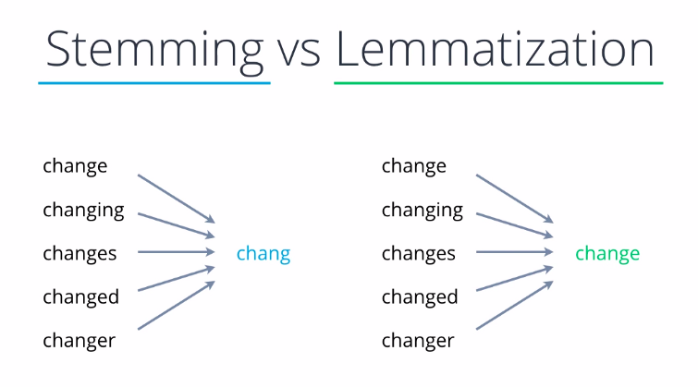
https://nirajbhoi.medium.com/stemming-vs-lemmatization-in-nlp-efc280d4e845

Slide 26
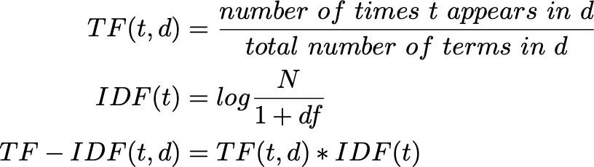
TF-IDF
TF – term frequency
IDF – inverse document frequency
Favors terms that are frequent in a given document but infrequent across the document collection, since
these terms best distinguish the given document from other documents in the collection. Greater weights are given to terms that occur less frequent in the corpus but are more frequently within a subset of documents. Common terms are usually not the most important nor do they provide differentiating semantics for different topics in the document collection.

Slide 27
Text Mining Process
Step 3: Extract patterns/knowledge
Use analytical methods applied to the structured vector of measurements based on the goals of the analysis,
Text categorization (supervised learning)
Clustering (unsupervised learning)
Association
Trend Analysis
…

Slide 28
Ambiguity Challenges from Natural Language Processing
Word-level ambiguity
“design” can be a noun or a verb
“root” has multiple meanings
Syntactic ambiguity
“A man saw a boy with a telescope.”
Anaphora resolution
“John persuaded Bill to buy a TV for himself.”
(himself = John or Bill?)
Presupposition
“He has quit smoking.” implies that he smoked before.

Slide 29
Text Data Quality Challenges
Noisy data
Example: Spelling mistakes
Not well structured text
Chat rooms
“r u available ?”
“Hey whazzzzzz up”
Speech

Slide 30
Parse Text

Slide 31
Key Definitions
A corpus
A collection of documents
A corpora
One document
A separators
A special character such as a blank or mark of punctuation
A token
A contiguous string of characters that does not contain a separator
Tokenization: identify basic units to be processed in text mining
A term
A token with a specific meaning in a given language

Slide 32
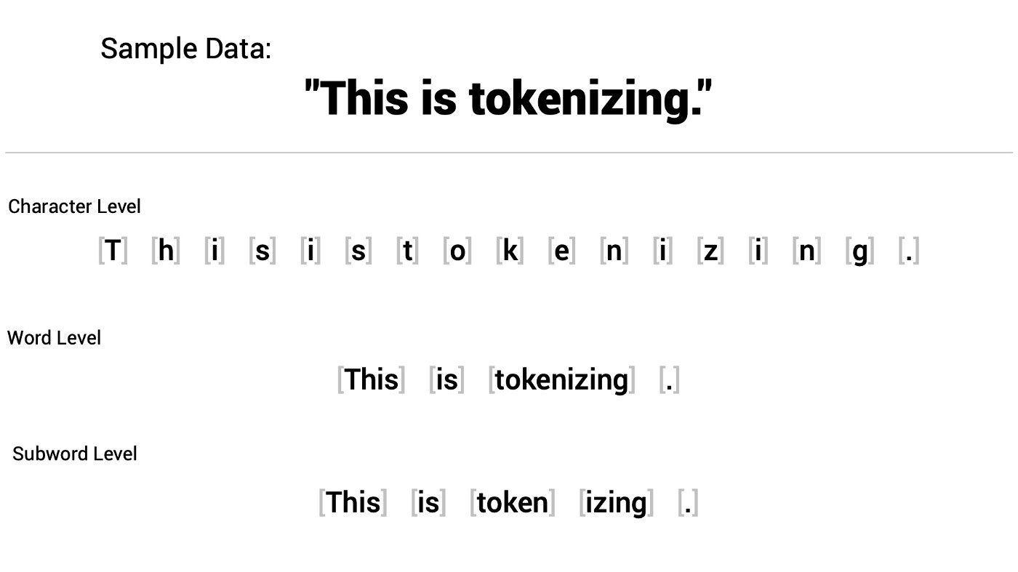
Pre-Processing: Tokenization
Process of breaking a stream of text up into words, phrases, symbols, or other meaningful elements called tokens.
Typically, segment English text on whitespaces and punctuation.
https://shaankhosla.substack.com/p/talking-tokenization

Slide 33
n-gram
n-gram: a continuous sequence of n tokens from a given text
unigram:
Default
Do not consider the order/sequence of the words
n-gram
Word is affected by its prior local context (last few words)
Larger n: more information about the context of the text (greater discrimination)
Smaller n: more instances in training data (more reliability)
More terms/features in the matrix
Increased sparseness of data

Slide 34
Zipf’s Law
Purpose: model the distribution of terms
Zipf’s law and its variants help quantify the importance of terms in a document collection. (Konchady 2006)
The product of the frequency of words (f) and their rank (r) is approximately constant
f * r = k (k is a constant, a positive integer)
The collection frequency of the r_{th} most common term is proportional to 1/r
If the most frequent term occurs k, then the second most frequent term has half as many occurrences (k/2), the third most frequent term has a third as many (k/3), etc.

Slide 35
Relevance of Zipf’s Law to Text Mining
Typically, there is the following in a document collection:
a high number of infrequent terms
an average number of average frequency terms
a low number of high frequency terms
Terms that are neither high nor low frequency are the most informative.
Often, a few, very frequent terms are not good discriminators.
Stop-words, for example, the, and, an, or, of

Slide 36
Important Pre-Processing
Stop-word removal
Stop-word list contains low information terms that only add noise to the analysis.
Stop-word has no descriptive or predictive value.
Stop-word examples
Articles (the, a, an)
Conjunctions (and, but, or)
Prepositions (of, from, by)
User-defined stop-words

Slide 37
Important Pre-Processing
Stemming
Documents tend to include words with different forms
Stemming:
A crude heuristic process that chops off the ends of words
Intends to combine words with different forms
Correctly most of the time
Verb stemming example:
Type, typed, typing, types
Noun stemming examples:
house, houses
matrix, matrices
criteria, criterion

Slide 38
Important Pre-Processing
Lemmatization
Alternative to stemming
Consider the context
Convert the word to its meaningful base form called lemma
Example
Stemming: studies → studi
Lemmatization: studies → study
Computationally expensive
Need linguistic dictionary to identify lemma

Slide 39
Text Summarization

Slide 40
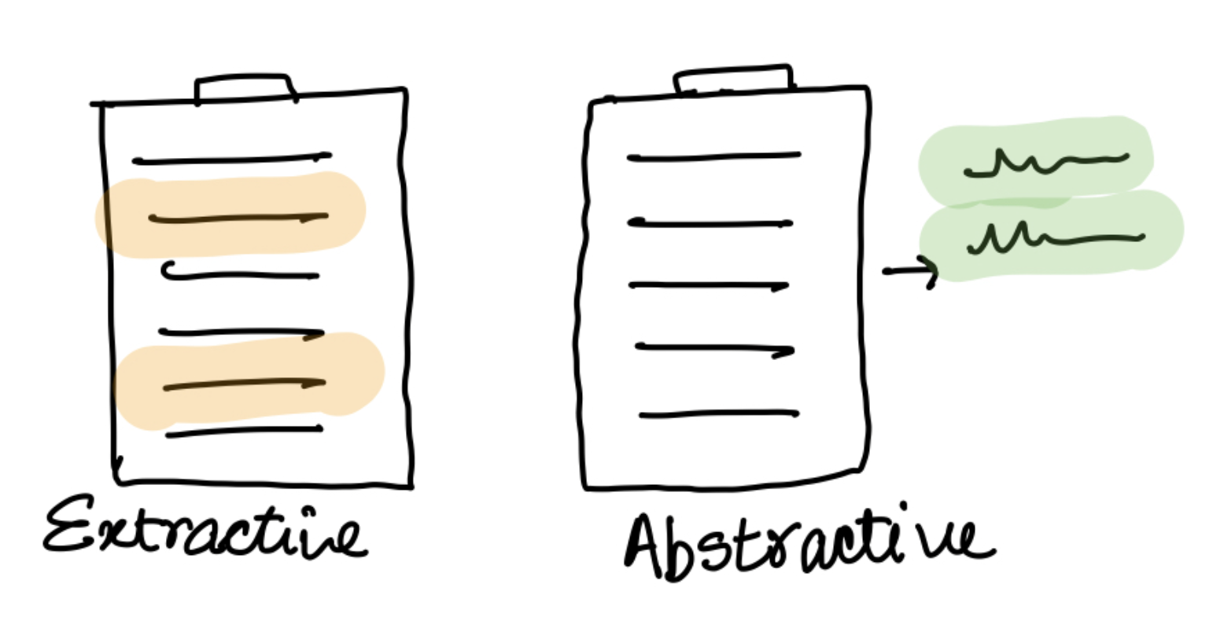
Text Summarization
Extractive summarization creates the summary by extracting words, phrases, sentences, and blocks of text from the original document without any alteration.
Abstractive summarization tries to create new unique text to summarize the source text.

Slide 41
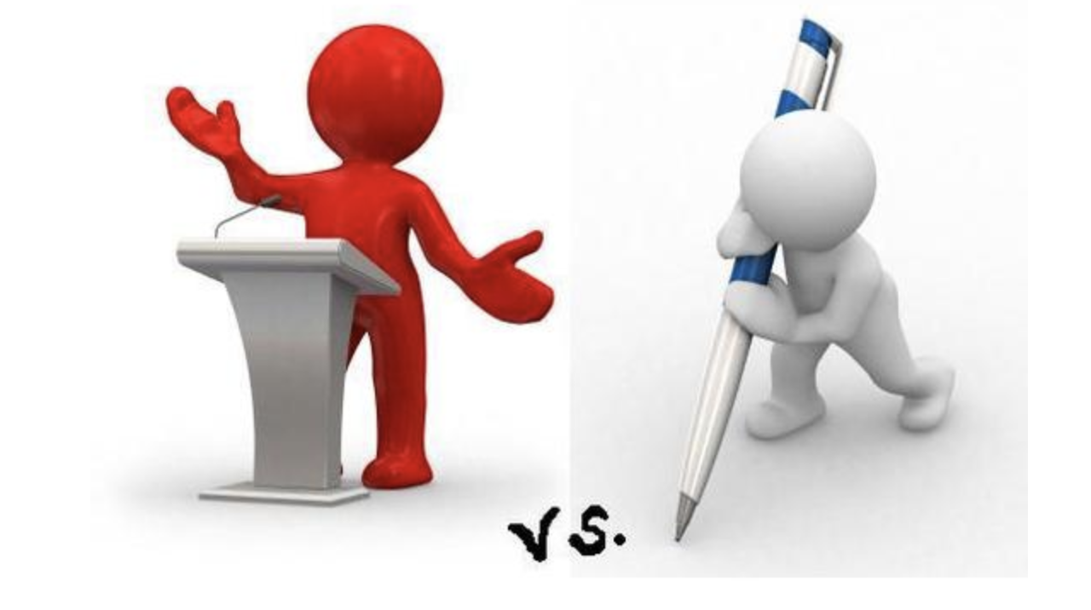
Text Summarization
Speech vs. Text
the level of details
structure of the sentences
grammatical correctness

Slide 42
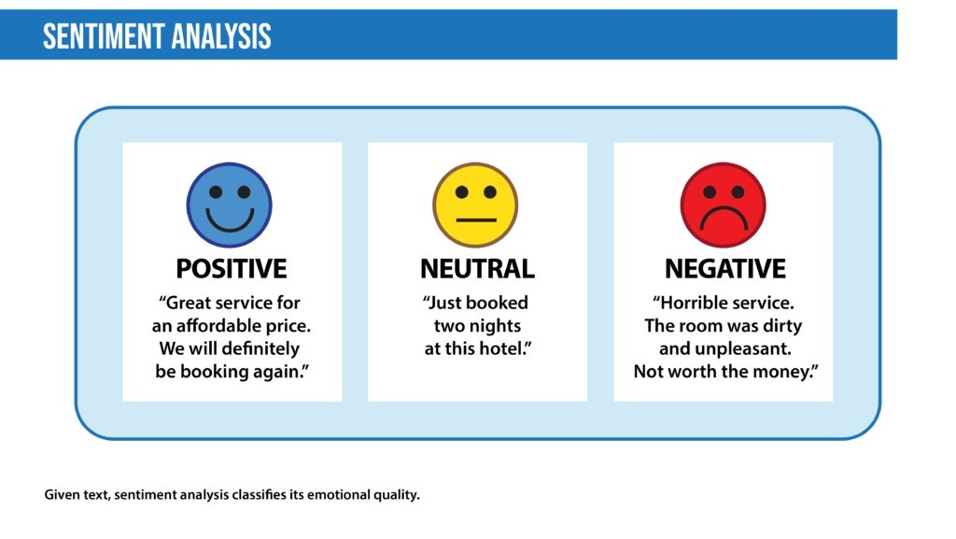
Sentiment Analysis
https://www.linkedin.com/pulse/sentiment-analysis-natural-language-processing-nlp-bushra-khanam/

Slide 43
Quantify Text

Slide 44
From Text to Numbers
Basic calculation per document:
Boolean counting (0-1) of terms
Frequency counting of terms
Information theoretic counting of terms (logarithm of frequency counts)
Adjusting for document size and corpus size ⇨ term weights:
Tf-idf
Others: entropy weights (Shannon information theory)

Slide 45
Issues with Simple Frequency
Issues
Longer documents will tend to have higher term counts
Terms that appear frequently across the corpus aren’t as important.
Tf-idf
Normalize documents based on their length
Penalize terms that occur frequently across the corpus

Slide 46
Tf-idf
Notations:
d: document
t: term
N: number of documents in the corpus
tf_{t,d} : the number of times that term t occurs in document d
df_{t} : the number of documents that contain term t
Term Variables
Documents
Term 1
Term 2
…
Term m
Document 1
Matrix
…
Document n

Slide 47
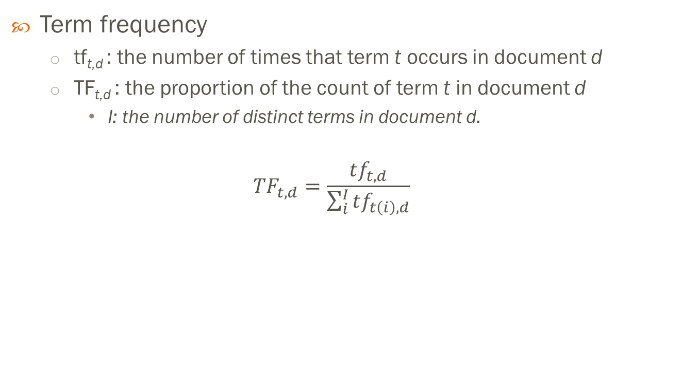
Term Frequency TF
Term frequency
tf_{t,d} : the number of times that term t occurs in document d
TF_{t,d} : the proportion of the count of term t in document d
I: the number of distinct terms in document d.
$${TF}_{t,d}=\frac{{tf}_{t,d}}{\sum_{i}^{I}{{tf}_{t\left(i\right),d}}}$$

Slide 48

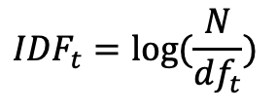
Inverse Document Frequency
df_{t} : the number of documents in the corpus that contain term t
Inverse Document Frequency (IDF)
$${IDF}_{t}=log⁡(\frac{N}{{df}_{t}})$$
$${0<IDF}_{t}<∞$$
Low Information
High Information

Slide 49
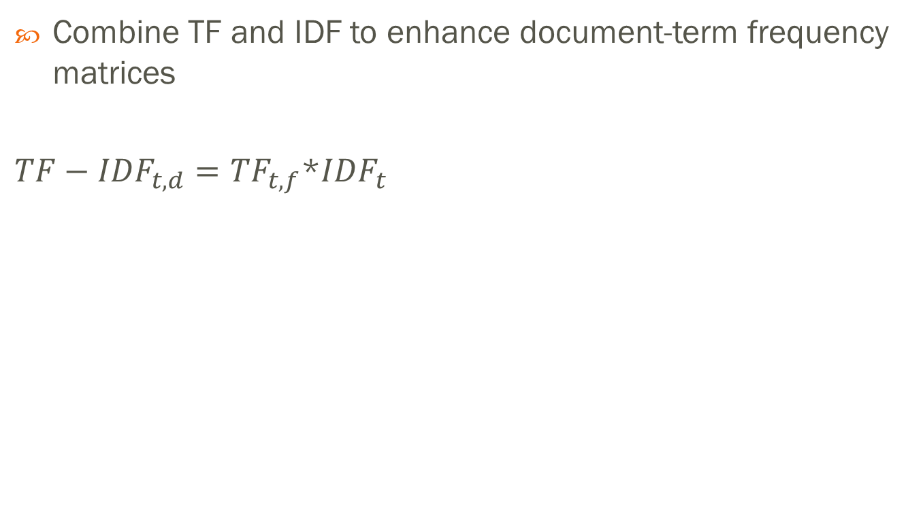
TF-IDF
Combine TF and IDF to enhance document-term frequency matrices
$TF−{IDF}_{t,d}={TF}_{t,f}$*${IDF}_{t}$

Slide 50
Latent Semantic Analysis via SVD

Slide 51
Quantifying Text Data
Term Variables
…
Documents
Variable 1
Variable 2
Variable 5280
Document 1
Data
…
Document 3000
Problems:
(1) Too big
(2) Sparse ⇨ mostly zeros

Slide 52
Linear Algebra in Text Mining
For a document collection, terms are counted in some fashion for each document.
With documents as rows (observations) and terms as columns (variables), the counts form a matrix.
The theory of linear algebra guarantees that every matrix accommodates a singular value decomposition (SVD).
The SVD of a document-by-term matrix produces a set of coefficients that can be used to derive concepts or topics from the document collection.

Slide 53
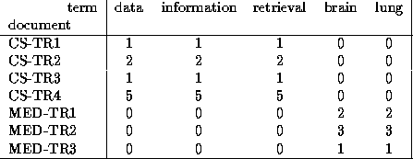
SVD Motivation
Objective 1: Find “concepts”
Objective 2: Compression / dimension reduction
Source: C. Faloutsos (2001)

Slide 54
Matrix Multiplication Review
x
=
3 x 2
2 x 1
3 x 1
Source: C. Faloutsos (2001)

Slide 55
Matrix Multiplication Review
x
=
3 x 2
2 x 1
3 x 1
Source: C. Faloutsos (2001)

Slide 56
Matrix Multiplication Review
x
=
3 x 2
2 x 1
3 x 1
Source: C. Faloutsos (2001)

Slide 57
Matrix Multiplication Review
x
=
Source: C. Faloutsos (2001)

Slide 58
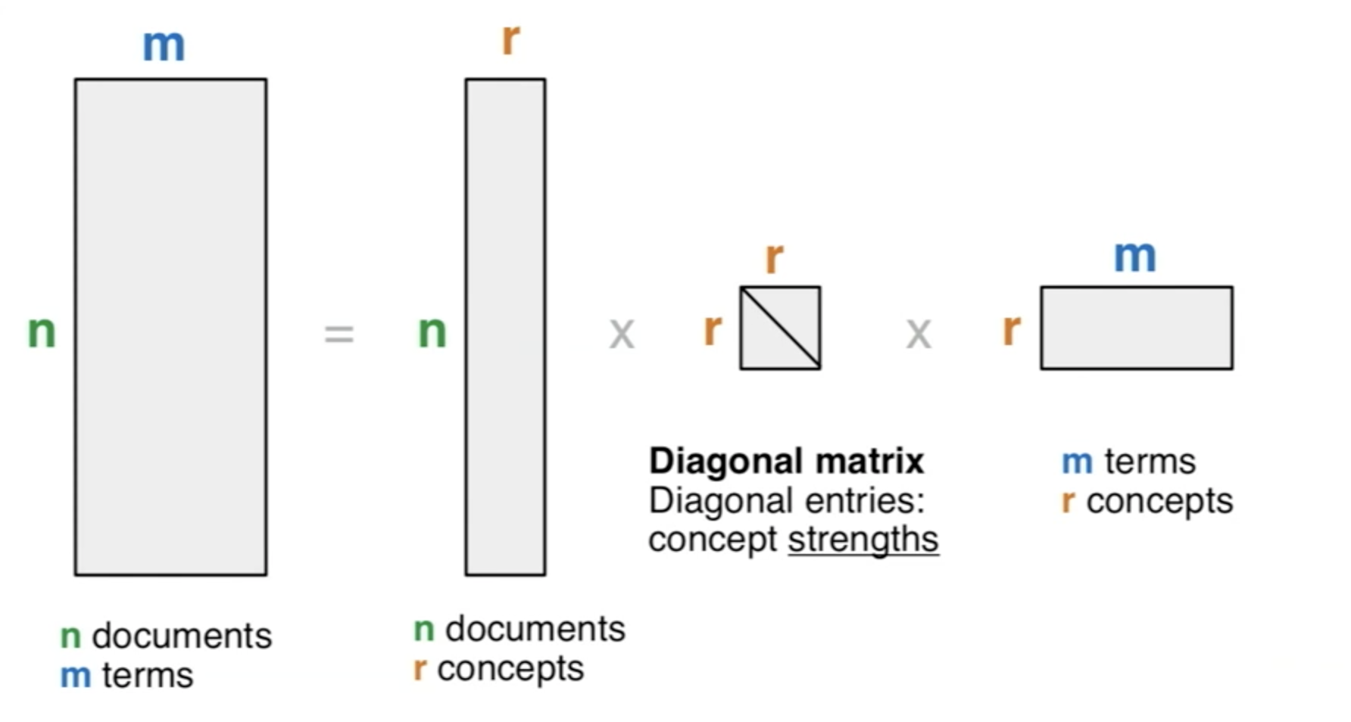
SVD Definition
A_{[n x m]} = U_{[n x r]} Λ _{[ r x r]} (V_{[m x r]})^{T}
Source: C. Faloutsos (2001)

Slide 59
SVD Definition
A_{[n x m]} = U_{[n x r]} Λ _{[ r x r]} (V_{[m x r]})^{T}
A: n x m matrix (eg., n documents, m terms)
U: n x r matrix (n documents, r concepts)
Λ: r x r diagonal matrix (strength of each ‘concept’) (r : rank of the matrix)
V: m x r matrix (m terms, r concepts)
Source: C. Faloutsos (2001)

Slide 60
SVD – Properties
Theorem (e.g., Eckart and Young 1936):
Always possible to decompose matrix A into $A=UΛV^{T}$
U, $Λ$ and V are unique
U and V are orthonormal ($UU^{T}=I)$
$Λ$ diagonal matrix with non-negative diagonal entries, sorted in decreasing order

Slide 61
SVD - Example
A = U Λ V^{T} - example:
data
inf.
retrieval
brain
lung
CS
=
x
x
MD
Source: C. Faloutsos (2001)

Slide 62
SVD - Example
A = U Λ V^{T} - example:
data
inf.
retrieval
brain
lung
‘strength’ of CS-concept
CS
=
x
x
MD
Source: C. Faloutsos (2001)

Slide 63
SVD - Example
A = U Λ V^{T} - example:
CS-concept
data
inf.
retrieval
brain
lung
MD-concept
CS
=
x
x
MD
Source: C. Faloutsos (2001)

Slide 64
SVD - Example
doc-to-concept
similarity matrix
A = U Λ V^{T} - example:
CS-concept
data
inf.
retrieval
brain
lung
MD-concept
CS
=
x
x
MD
Source: C. Faloutsos (2001)

Slide 65
SVD - Example
A = U Λ V^{T} - example:
data
inf.
retrieval
brain
lung
term-to-concept
similarity matrix
CS-concept
CS
=
x
x
MD
Source: C. Faloutsos (2001)

Slide 66
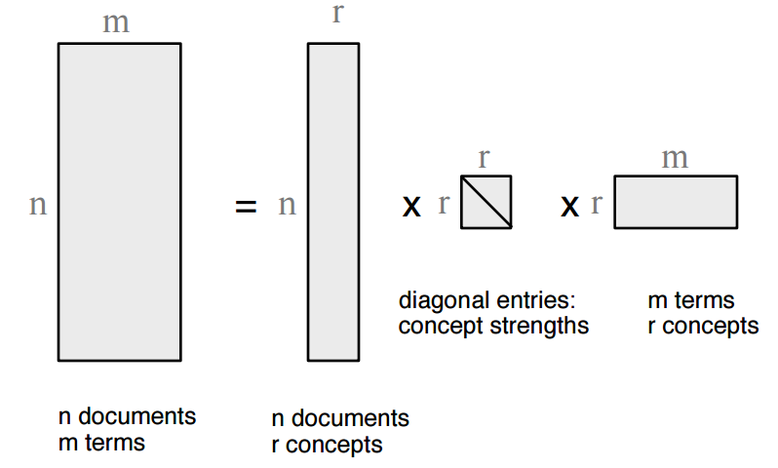
SVD Interpretation
A_{[n x m]} = U_{[n x r]} Λ _{[ r x r]} (V_{[m x r]})^{T}
Documents, terms, and concepts
U: document-to-concept similarity matrix
Λ: its diagonal elements represent the strength of each concept
V: term-to-concept similarity matrix

Slide 67
Dimensionality Reduction
There are as many SVD dimensions as there are kept terms in the document collection.
For example, if there are 5,280 kept terms (Keep Status=Yes), then there are 5,280 SVD columns.
The SVD algorithm derives SVD weights in order of importance.
Thus, the concept represented by _SVD_1 is more important than the concept represented by _SVD_2, and so on.
There is a cutoff k such that SVD concepts beyond the first k are not important. The value k is usually much smaller than the total number of terms.
Set the smallest singular values to zero.

Slide 68
Dimension Reduction
~
x
x

Slide 69
Dimension Reduction
~

Slide 70
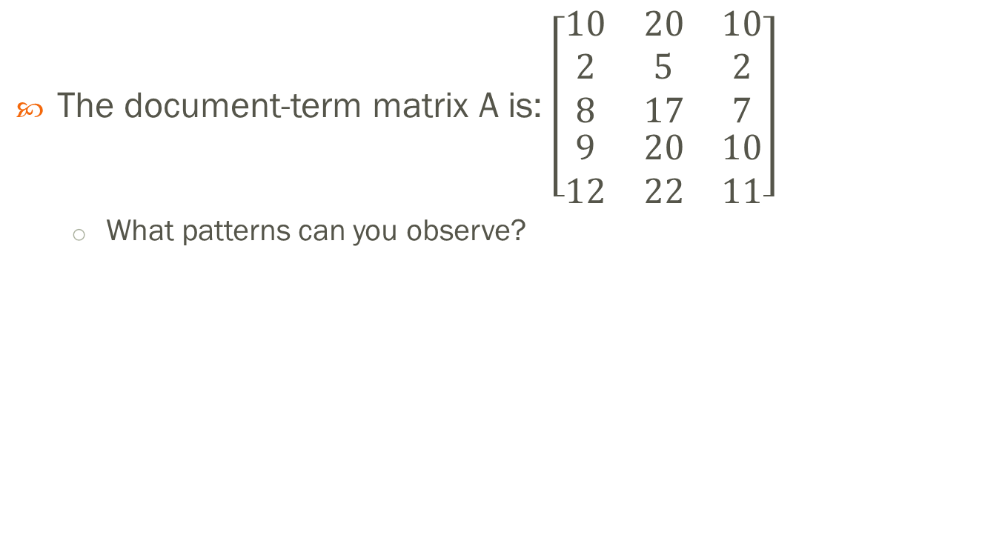
SVD – Example 2
The document-term matrix A is: $\left[\begin{aligned}\begin{matrix}10 & 20 & 10 \\ 2 & 5 & 2 \\ 8 & 17 & 7\end{matrix} \\ \begin{matrix}9 & 20 & 10 \\ 12 & 22 & 11\end{matrix}\end{aligned}\right]$
What patterns can you observe?

Slide 71
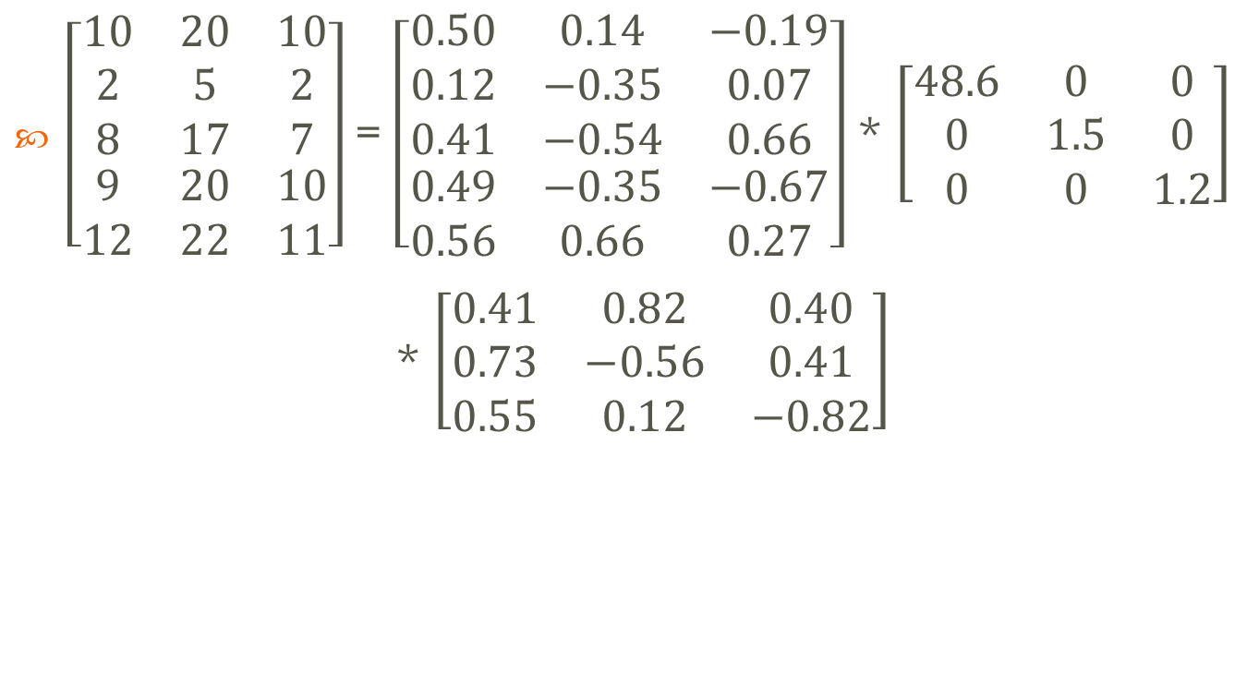
SVD – Example 2
$\left[\begin{aligned}\begin{matrix}10 & 20 & 10 \\ 2 & 5 & 2 \\ 8 & 17 & 7\end{matrix} \\ \begin{matrix}9 & 20 & 10 \\ 12 & 22 & 11\end{matrix}\end{aligned}\right]$ = $\left[\begin{aligned}\begin{matrix}0.50 & 0.14 & −0.19 \\ 0.12 & −0.35 & 0.07 \\ 0.41 & −0.54 & 0.66\end{matrix} \\ \begin{matrix}0.49 & −0.35 & −0.67 \\ 0.56 & 0.66 & 0.27\end{matrix}\end{aligned}\right]$ * $\left[\begin{matrix}48.6 & 0 & 0 \\ 0 & 1.5 & 0 \\ 0 & 0 & 1.2\end{matrix}\right]$
* $\left[\begin{matrix}0.41 & 0.82 & 0.40 \\ 0.73 & −0.56 & 0.41 \\ 0.55 & 0.12 & −0.82\end{matrix}\right]$

Slide 72
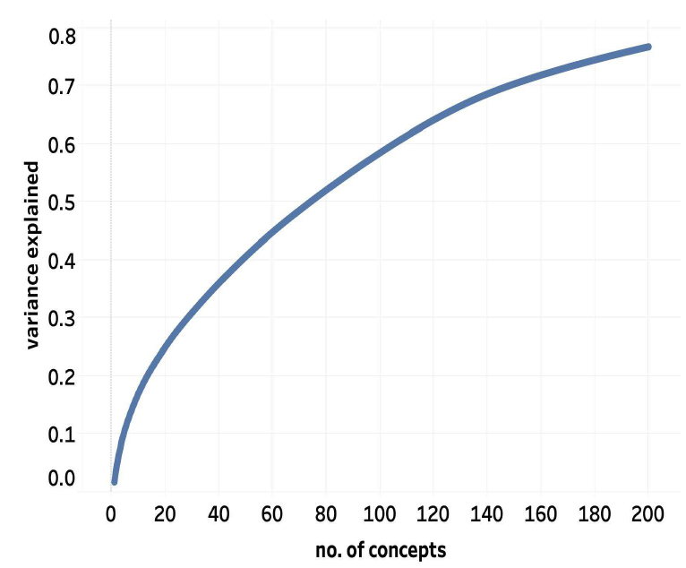
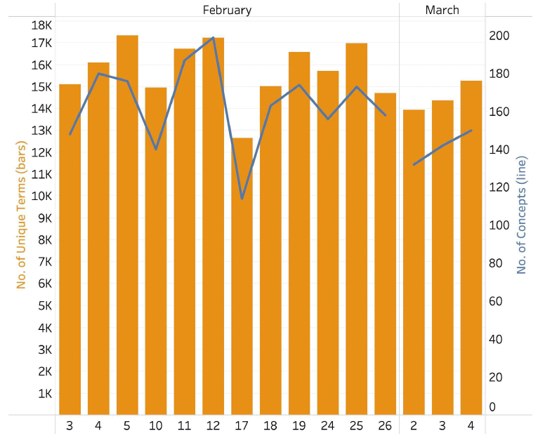

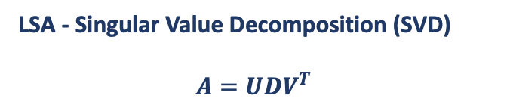
SVD
$$A=πr^{2}A=$$
Data Collection
Text Preprocessing
Dimensionality reduction
Cluster Analysis
LSA - Singular Value Decomposition (SVD)
$$A=UDV^{T}$$
Topic identification
optimal # of concepts
optimal # of clusters
date

Slide 73
Topic Modeling

Slide 74
Topic Modeling
Topic modeling: automatically classifying sets of documents into topics or themes
Algorithm
Latent Dirichlet Allocation (LDA)
Adjust the relative importance of topics in documents and words in topics iteratively.
References:
https://eight2late.wordpress.com/2015/09/29/a-gentle-introduction-to-topic-modeling-using-r/
https://www.quora.com/What-is-a-good-explanation-of-Latent-Dirichlet-Allocation

Slide 75
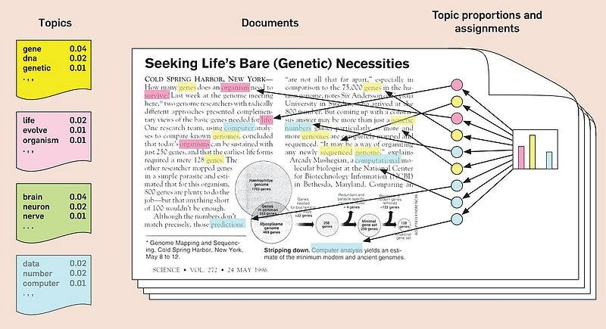
LDA
https://medium.com/@connectwithghosh/topic-modelling-with-latent-dirichlet-allocation-lda-in-pyspark-2cb3ebd5678e

Slide 76
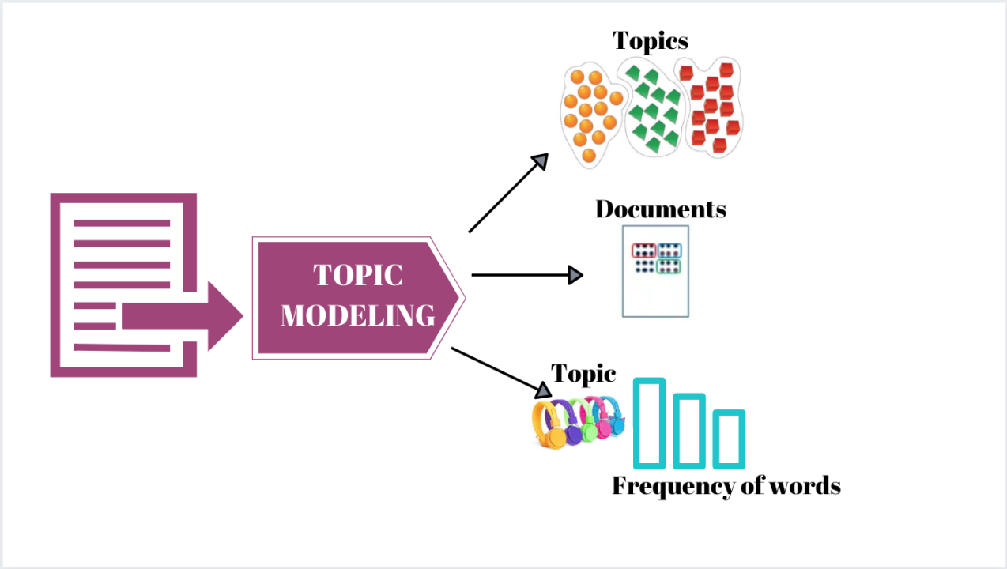
LDA
https://www.linkedin.com/pulse/topic-modeling-python-using-latent-dirichlet-lda-prashanth-srinivasan/

Slide 77
Topic Modeling
Go through each document, and randomly assign each word in the document to one of the K topics.
Note: One of the shortcomings of LDA is that one has to specify the number of topics, denoted by K, upfront.
This assignment already gives you both topic representations of all the documents and word distributions of all the topics (albeit not very good ones).
So to improve on them, for each document d…
Go through each word w in d…
And for each topic t, compute two things: 1) p(topic t | document d) = the proportion of words in document d that are currently assigned to topic t, and 2) p(word w | topic t) = the proportion of assignments to topic t over all documents that come from this word w.
Reassign w a new topic, where you choose topic t with probability p(topic t | document d) * p(word w | topic t) (the probability that topic t generated word w).
After repeating the previous step a large number of times, you’ll eventually reach a roughly steady state where your assignments are pretty good.
Estimate the topic mixtures of each document
Estimate the words associated to each topic

Slide 78
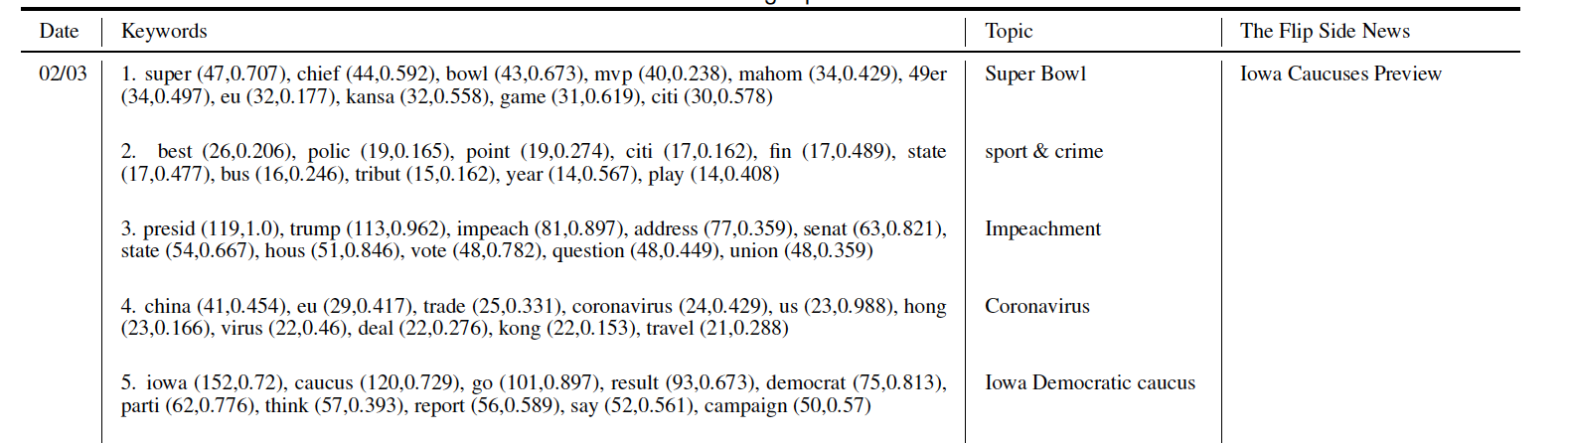
Topic Modeling
highest # in document
in-cluster frequency

Slide 79
Similarity Measures

Slide 80
Compare Two Documents
View two documents as two vectors
Similarity can be measure by
Correlation
Euclidean distance
Cosine similarity (implemented in the Gensim library)
Others
We can perform hierarchical clustering based on distance measures
 | Term 1 | Term 2 | … | Term m
Document 1
Document 2

Slide 81
Cosine Similarity
Cosine similarity: similarity of vectors d1 and d2 measured by the cosine of the angle x between them
t ₂
d ₂
d ₁
θ
t ₁

Slide 82
Compare Two Terms
View two documents as two vectors
Similarity can be measure by
Correlation
Euclidean distance
Cosine similarity
Others
 | Doc 1 | Doc 2 | … | Doc n
Term 1
Term 2

Slide 83
Compare Two Terms
Word embedding model (Word2vec)
A neural network-based model
Input: a large corpus of text
Output: a vector space with several hundred dimensions
Each word is assigned a vector
Words sharing common contexts are located close to one another in the vector space

Slide 84
Examples

Slide 85
Stylometry
Alexander Hamilton, James Madison, and John Jay wrote a series of essays in 1787 and 1788 to try to convince the citizens of the state of New York to ratify the new constitution of the United States. These essays are collectively called The Federalist: A Collection of Essays.
Author | Number of Essays
Alexander Hamilton | 51
James Madison | 14
John Jay | 5
Hamilton and Madison | 3
Unattributed | 12
Total | 85

